Slide 1
Recognizing Seven-Segment Digits using Computer Vision
Team name: SmartReader
Team type: D-team
Team members: Navodit Chandra, Yun Sik Ohm,
Johansson George Jose
Notes:
Hello everyone, we are team SmartReader. I’m Yun, this is Navodit and Johansson. We are going to talk about recognizing seven segment digits using computer vision.

Slide 2
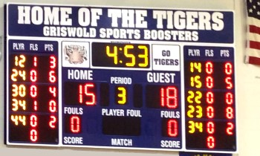
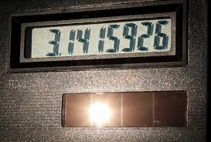

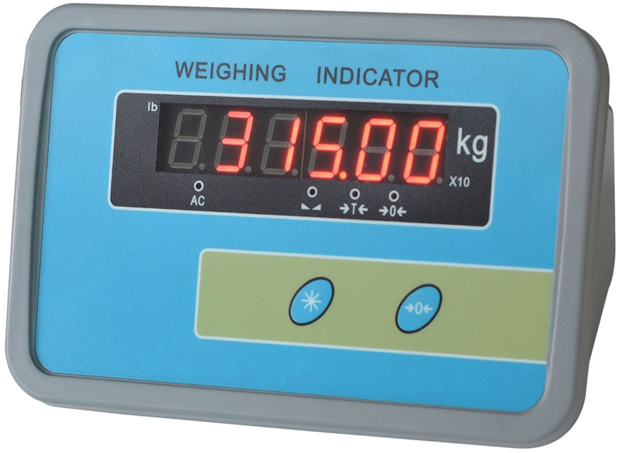
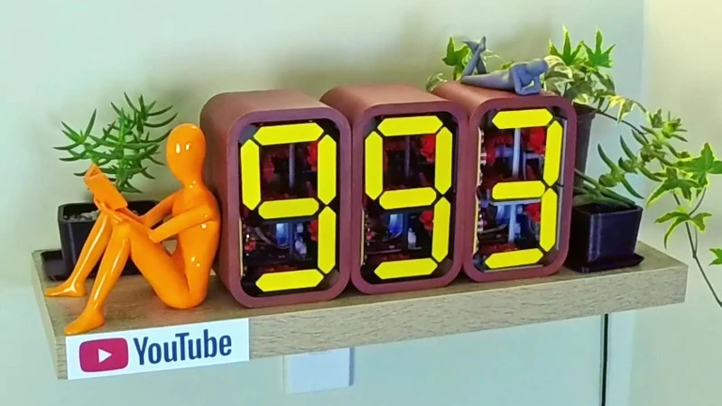
Have you ever seen these numbers?
Seven-segment digit
Notes:
Let me ask you some questions first. Have you ever seen these numbers in the following images? Numbers on a scoreboard. Numbers on an old-fashioned calculator. Or some of you might have seen how heavy you are on weight scale. Or even who knows some of you are Youtubers and you have this kind of thing that can count the number of your subscribers. (Click) These numbers are called seven segment digits. Which means that you can make these numbers using only seven segments.

Slide 3
Have you ever tried to record these numbers?
Seven-segment digit
Notes:
Then let me ask you another question. Have you ever tried to record these numbers? It sounds straightforward right?. You can just look and type.

Slide 4
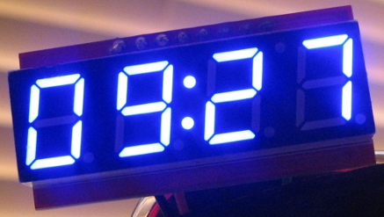
Have you ever tried to record these numbers?
Well…
What about 1,000 images?
Notes:
Well, what about 1000 images of them? Obviously, it becomes not fun anymore. It can be tedious, boring, or it can make you fall asleep. Then you might have a lot of typos. And it becomes not an easy task anymore.

Slide 5
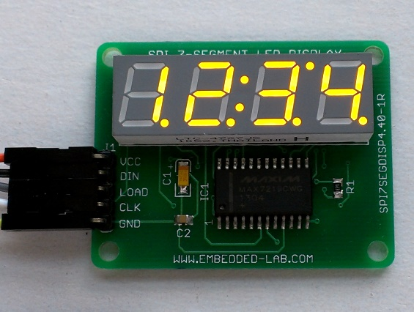
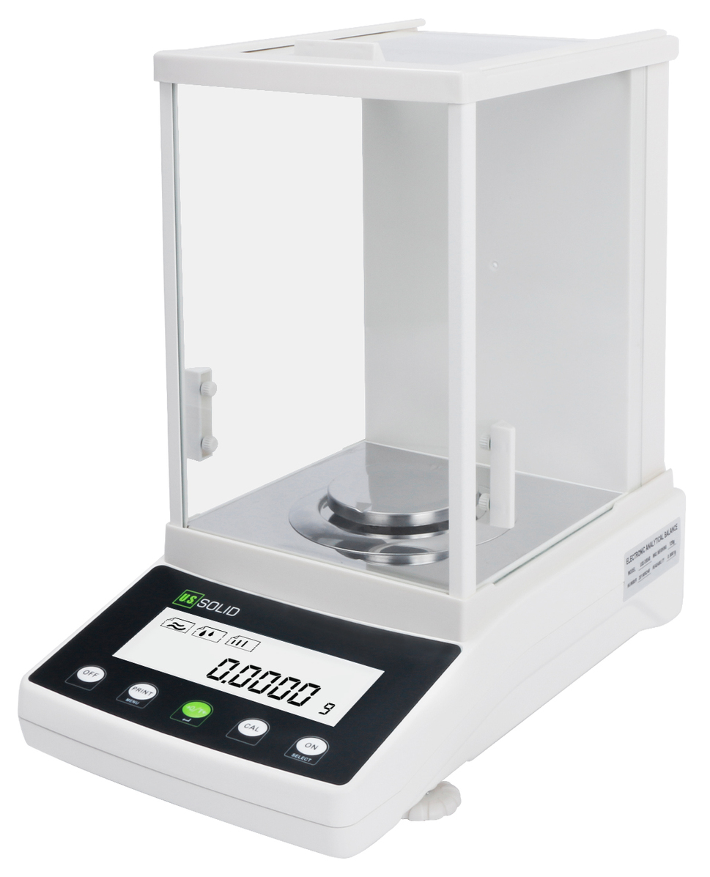
Why do we need to record these numbers?
Most digital equipment use these numbers for converting digital signals into a form that can be displayed and understood by the user.
This information is often numerical data in the form of numbers.
[Ref] https://www.electronics-tutorials.ws/blog/7-segment-display-tutorial.html#:~:text=Most%20digital%20equipment%20us e%207,of%20numbers%2C%20characters%20and%20symbols.
Notes:
Alright, but why do we need to record these numbers? Based on this reference, a lot of digital equipment use seven segment numbers to display digital data. And most of them do not have functionality to transfer the data digitally. That’s why we need to find a way to record these numbers.

Slide 6

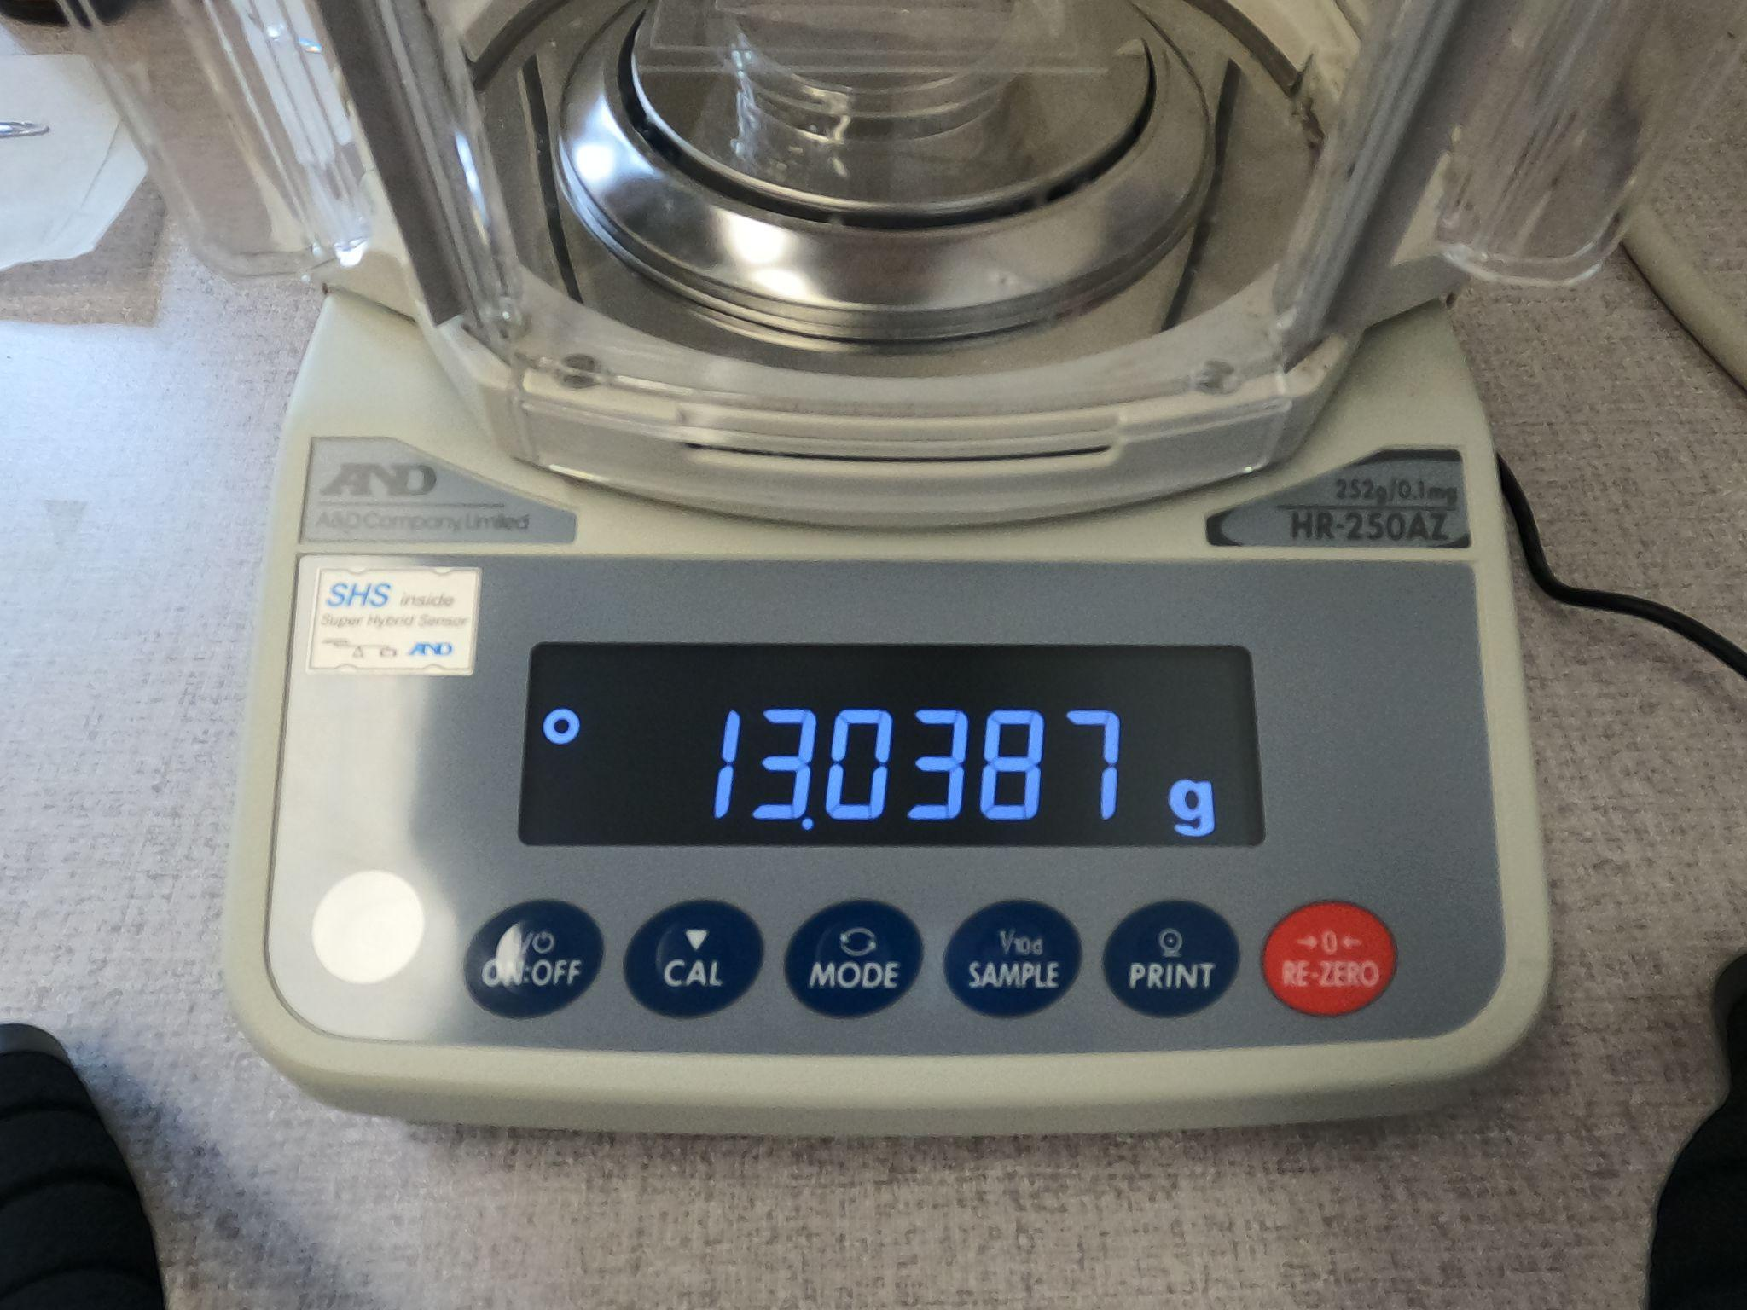
How can we record these numbers?
One of the most straightforward methods is typing.
How fast can people type? (WPM: Word per Minute,
CPM: Character per Minute, 1 word is approx. 5 characters)
Average computer typist
7 characters: 2 seconds
41 WPM = 205 CPM
500 images: 17 minutes
Fastest English language typist
216 WPM
The world’s fastest speaker
637 WPM
[Ref 1] https://www.ratatype.com/learn/average-typing-speed/
[Ref 2] http://www.asarif.com/pub/Arif_TIC-STH2009.pdf
[Ref 3] https://www.livechat.com/typing-speed-test/#/
Notes:
How can we record these numbers? The easiest answer can be typing. According to some statistics, average people can type 41 words per minute. (click) Let’s do some simple calculations. If we have 7 characters to type in, it will take 2 seconds to write. If we have 500 images of them, then it will be 17 minutes. Well, it doesn’t sound fun right? And it seems pretty inefficient.

Slide 7

Using computer vision could be more efficient!
Image processing
Cropping
Sharpening
Gamma correction
Deleting dots
…
Recognition
Performance
We used GoPro to take a set of images (There are around 500 images each set).
Time
Accuracy
Notes:
Here, we propose that using computer vision can be more efficient to record the numbers. This program takes a set of images and recognizes seven segment digits. In this presentation, we will talk about what the code does, how it can recognize the numbers, and how well our program performs.

Slide 8
Detection of the region of interest - Seven-segment display
Image Processing
Notes:
I would like to first talk about the step by step process used by us for this task
Presenters Title: 16 pt. Arial Italic

Slide 9
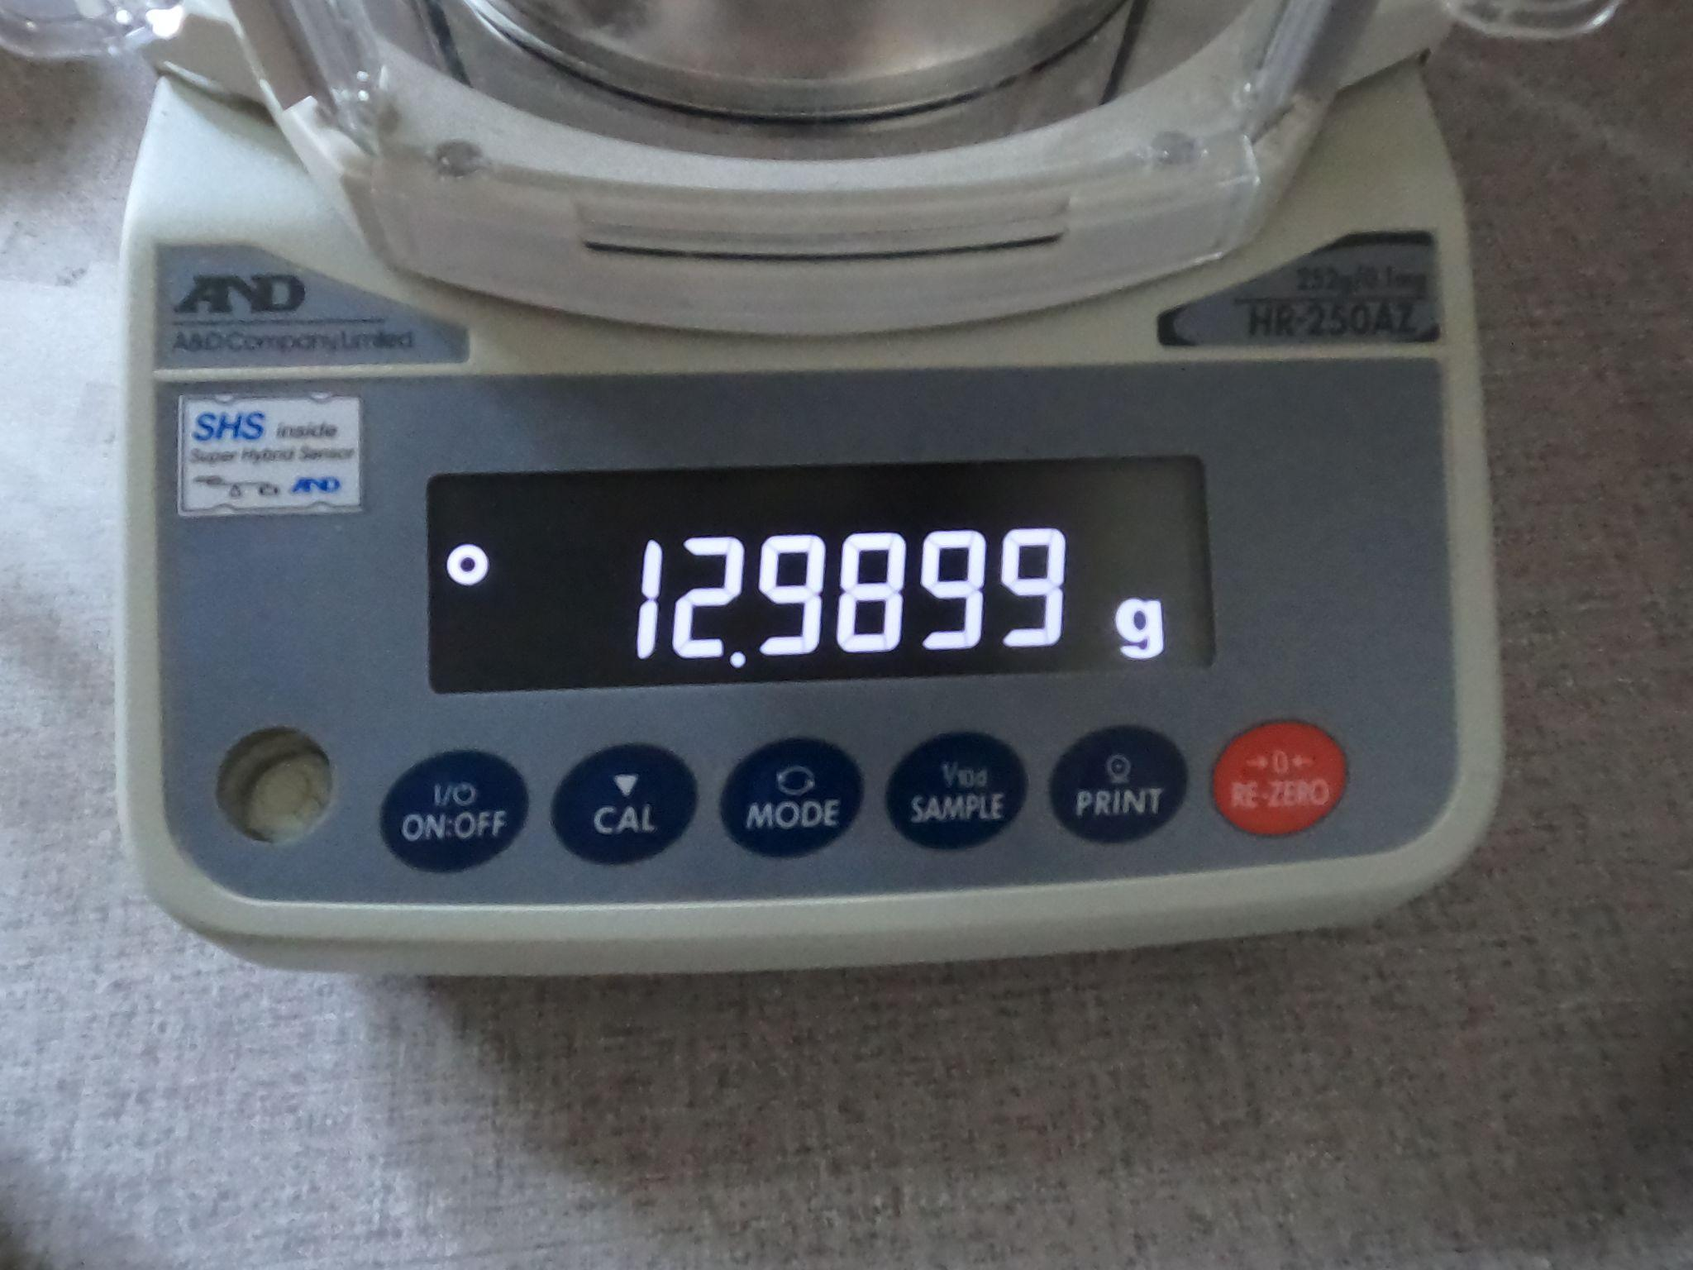
Detection of the seven-segment display depicting the decimal numerals
Plausible ways to extract the 7-segment display:
Contour detection
Manual cropping
Making use of the mouse for cropping
Sample image from the dataset

Slide 10

Contour detection
Contour detection does not yield good results
A detour is observed across the contour detected by OpenCV
The low resolution and content of the image are primarily responsible for this
Application of contour detection in an attempt to extract the 7-segment display

Slide 11
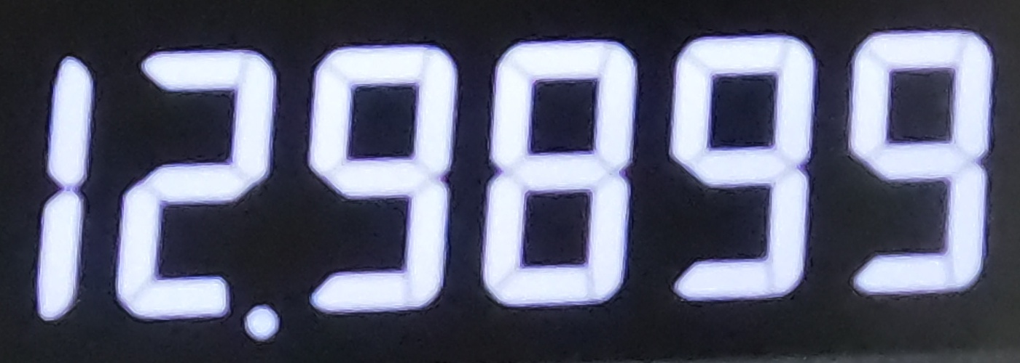
Manual cropping
Computationally inexpensive
Yields accurate results
Involves hardcoding the region of interest and may not generalize well
Iterative procedure for finding the coordinates of the region of interest
Cropped image

Slide 12
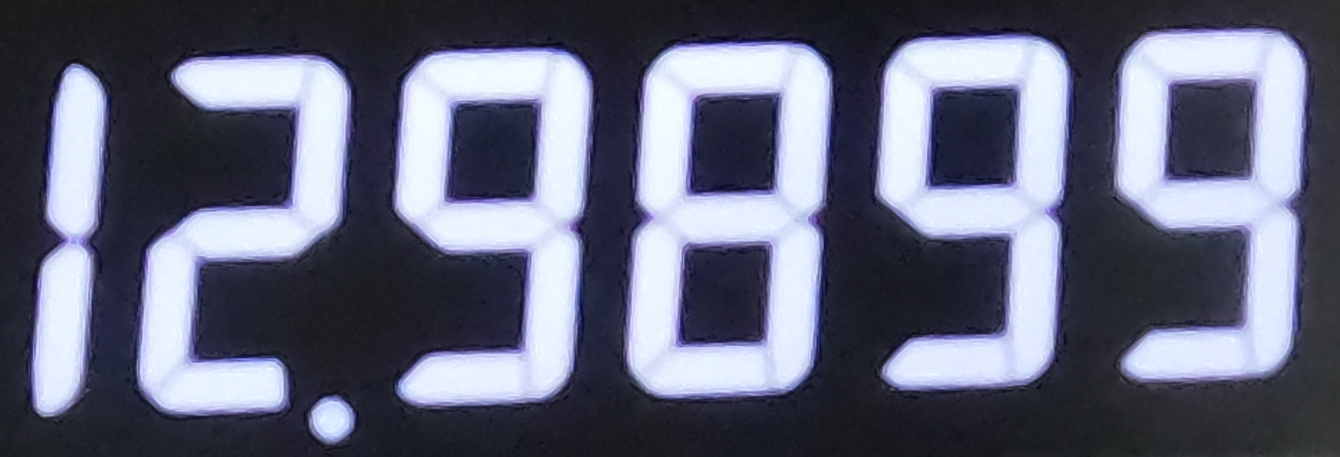
Extracting the region of interest using the mouse
Using the mouse seems to be a pretty elegant way!
Also yields accurate results
Might not be a very convenient alternative if there are a large number of readings which need to be taken successively
Cropped image

Slide 13
Blurred digits in the seven-segment display
Image Processing
Notes:
Main title: 40 pt. Arial
Presenter Name: 16 pt. Arial
Presenters Title: 16 pt. Arial Italic

Slide 14
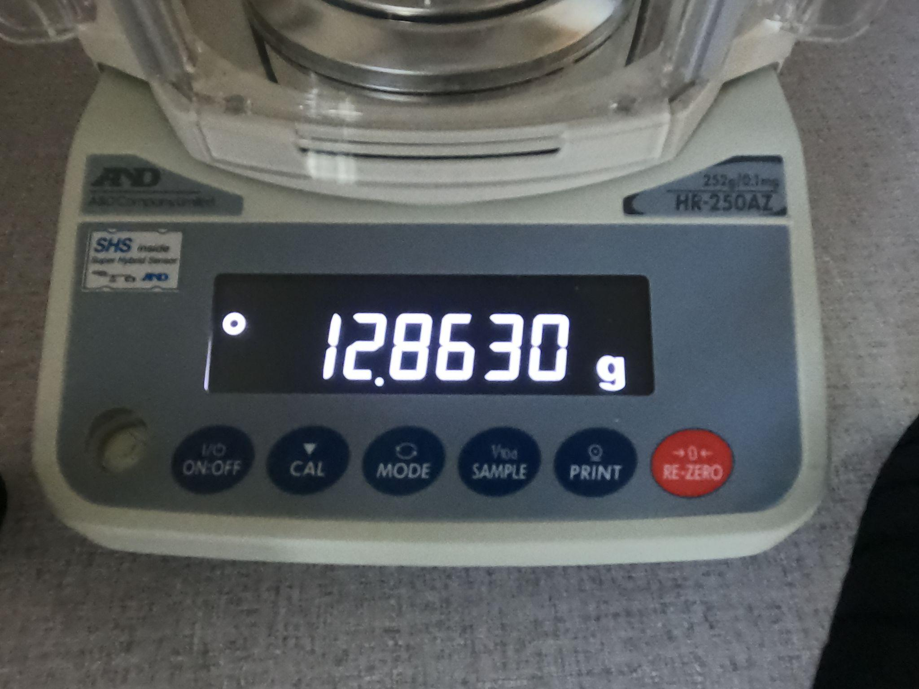
How to address the issue of a blurred seven segment display?
Use of sharpening techniques to emphasize the edges of the decimal numerals
Possible techniques:
Unsharp masking
Sharpening filter
Sample image from the dataset

Slide 15
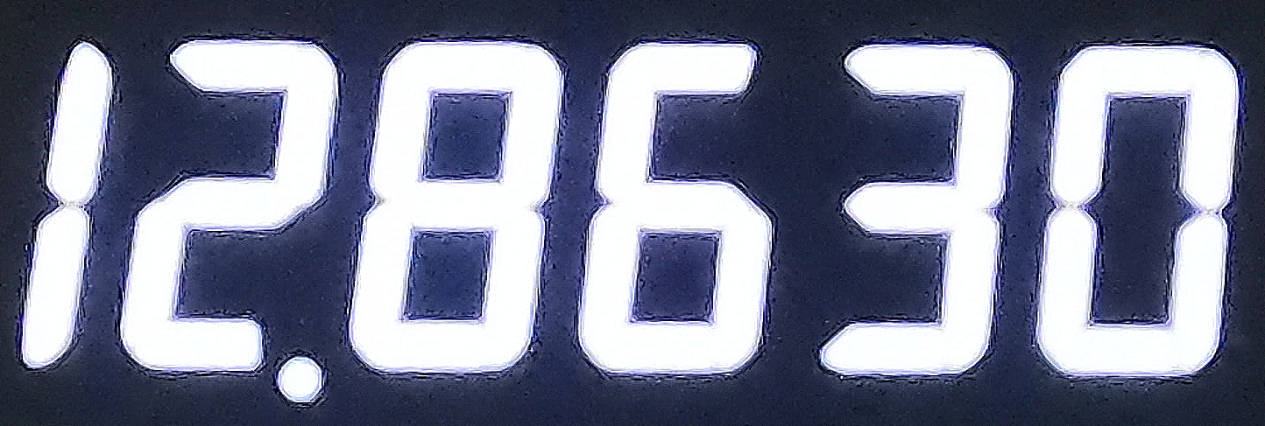
Implement sharpening techniques to emphasize edges
The benefit of sharpening would be that no mistake is made in the recognition of digits while making use of the seven segment digit recognition algorithm
Sharpened image

Slide 16
What if readings need to be taken on a bright sunny day!
Image Processing
Notes:
An interesting scenario arises if we want to make use of computer vision to take readings on a sunny day.

Slide 17
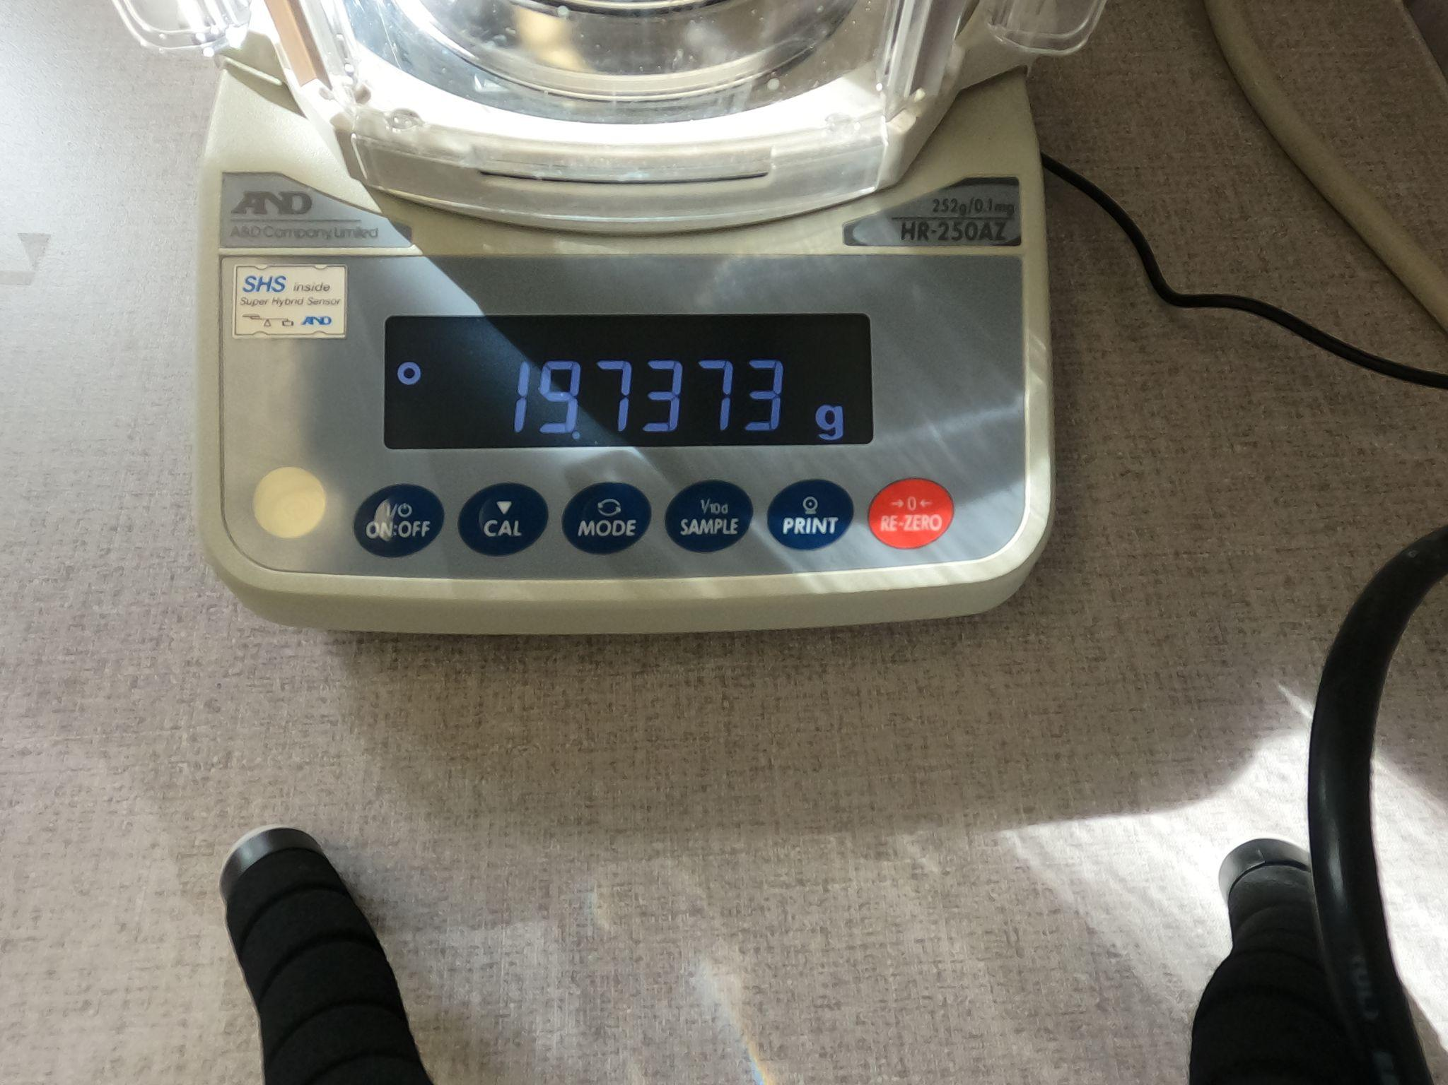
What if you want to use computer vision for taking readings on a sunny day?
A streak of sunlight might appear across the seven segment display screen on a particular day
Effective way to address this issue:
Gamma correction
Sample image from the dataset

Slide 18
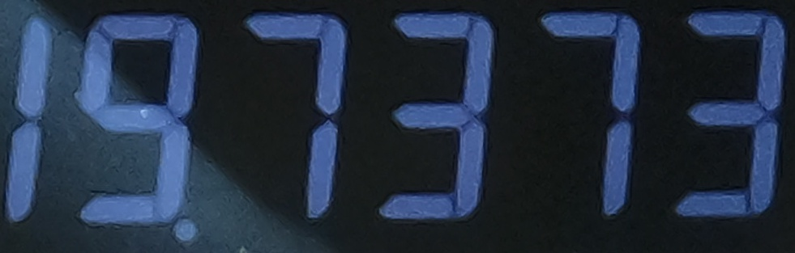
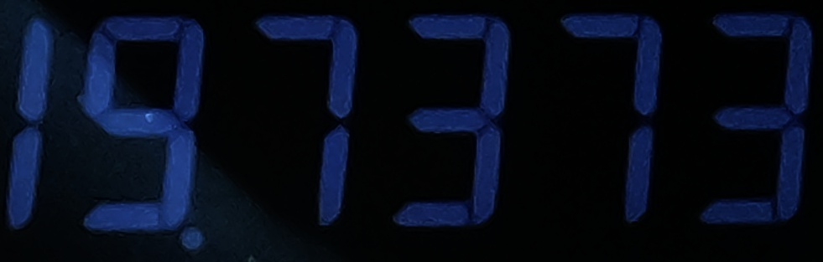
Use Gamma correction
Gamma correction is applied to adjust the brightness for uniformity across the cropped image
The image gets improved for steps lying ahead such as forming bounding boxes for identifying the digits
The image gets darker but does not cause issues for the seven-segment digit recognition algorithm
Streak of sunlight removed but the image gets darker

Slide 19
Forming bounding boxes over the digits
Image Processing
Notes:
Main title: 40 pt. Arial
Presenter Name: 16 pt. Arial
Presenters Title: 16 pt. Arial Italic

Slide 20
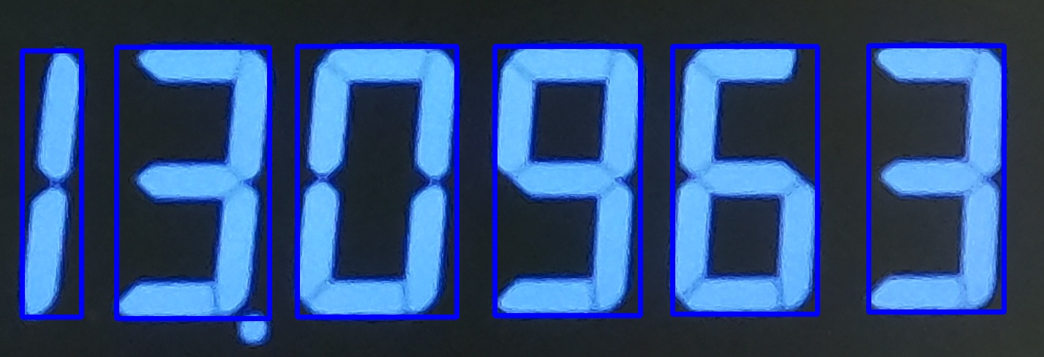
Bounding boxes need to be formed the detected digits
Contour detection works well for the digits in the image!
These contours need to be sorted according to their x-coordinates in the image
An iterative trial and error procedure need to be followed to determine appropriate width and height constraints for the bounding boxes
Bounding boxes over the cropped image

Slide 21
Dealing with the decimal point
Image Processing
Notes:
How do we deal with the decimal point?

Slide 22
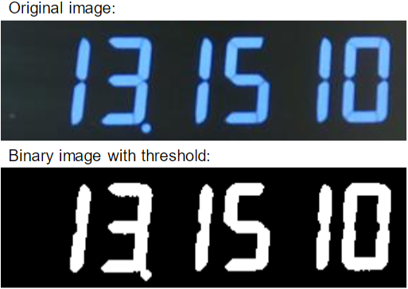
What about the dot?
In the original image, there is one dot that functions as a decimal separator
However, this dot can cause some failures in our algorithm
Sample image from the dataset
Binary Thresholded image
Notes:
As you can see 7 segment displays often have a decimal point to separate the whole numbers from the fractionals. But this can cause problems in the program.

Slide 23
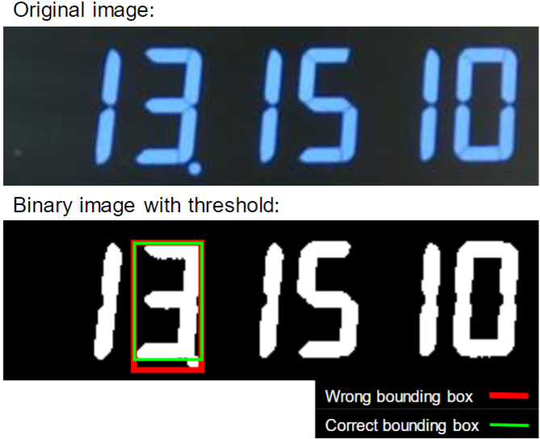
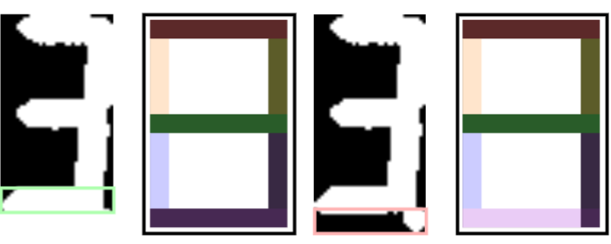
The dot can affect the size of the bounding box
The algorithm tends to connect the discontinued segments
In the process, the dot can be connected to a number
Therefore, the bounding box cannot be formed properly
The wrong bounding box can generate wrong output from the search algorithm, specifically about the very bottom segment
Notes:
The algorithm tends to overlap the dot with the number, causing the bounding box to be enlarged. As a result, you can see in the image on the right that the bottom edge of the bounding box extends over the decimal point causing the program to miss the bottom segment of the number.

Slide 24
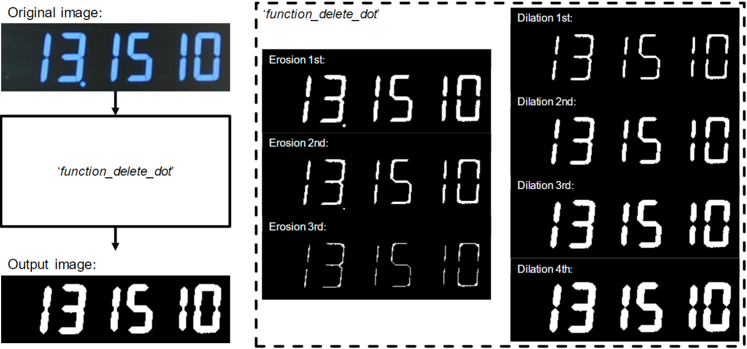
Solving the dot problem
To eliminate the dot, we used simple erosion and dilation operations
The placement of the dot is stored in the program for the correct number to be output
Notes:
To solve the problem, we used erosion and dilation operations. We eroded the images until the dot disappeared and then dilated them back up to size. The placement of the dot is also stored in the program so that the correct values are output.

Slide 25
The code is sweeping each segment in every bounding box
Recognition
Notes:
In this section, I wanna talk about how our program can recognize seven segment digits.

Slide 26
Color visualization for 7 segments
1
7 segments in rainbow color: [R O Y G B I V]
2
3
R: Red
O: Orange
Y: Yellow
G: Green
B: Blue
I: Indigo
V: Violet
[255, 0, 0]
[255, 127, 0]
[255, 255, 0]
[ 0, 255, 0]
[ 0, 0, 255]
[ 75, 0, 130]
[148, 0, 211]
#FF0000
#FF7F00
#FFFF00
#00FF00
#0000FF
#4B0082
#9400D3
4
5
6
7
Notes:
In order to get better understanding of what the code is doing behind the scenes, we visualized 7 segments using the 7 color that we learned in the class. Basically, the code takes each segment one by one and then decide whether that segment is filled or not. We will take one example and follow how it actually works.

Slide 27

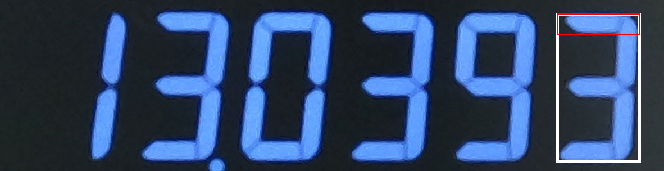
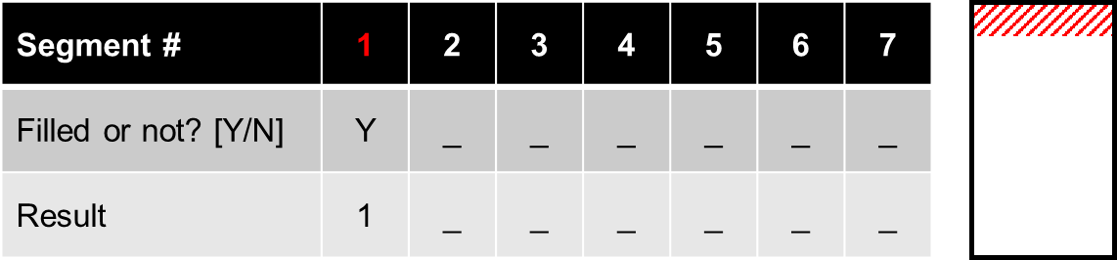
Sweeping each segment: 1st segment
Notes:
This is one example and we are going to recognize the last digit of the seven segment numbers. First of all, our program takes a look at the first segment. And it is filled, so the program saves 1 in the result tuple.

Slide 28

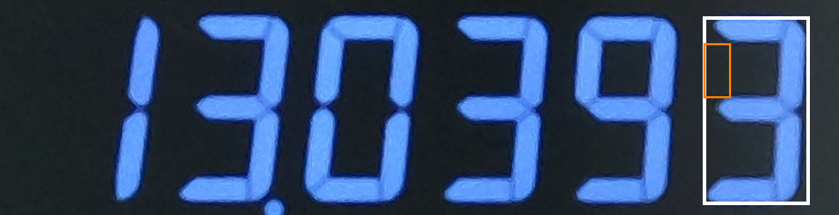
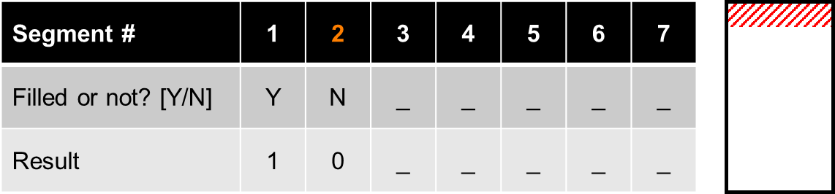
Sweeping each segment: 2nd segment
Notes:
For the second segment, as you can see it is not filled. So there is 0 in the result.

Slide 29

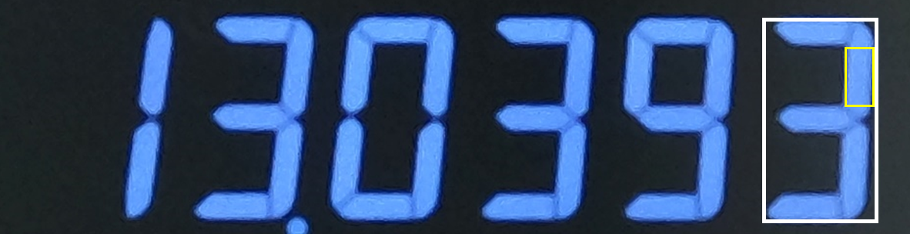
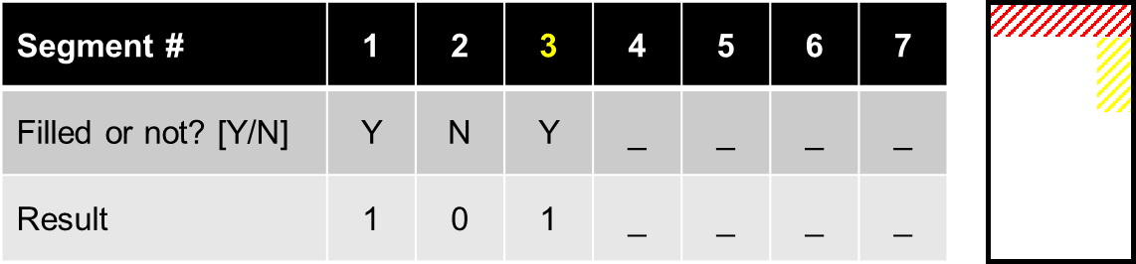
Sweeping each segment: 3rd segment
Notes:
In the same way, the program saves 1 for the 3rd segment.

Slide 30

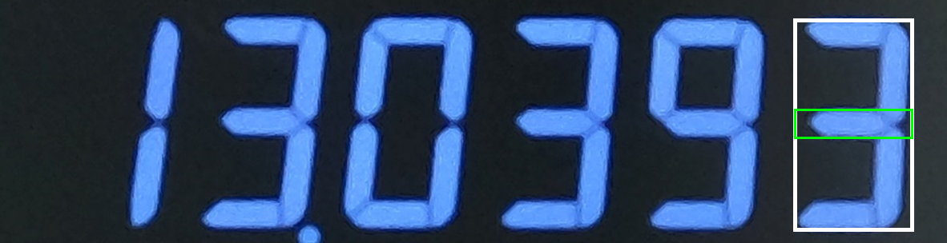
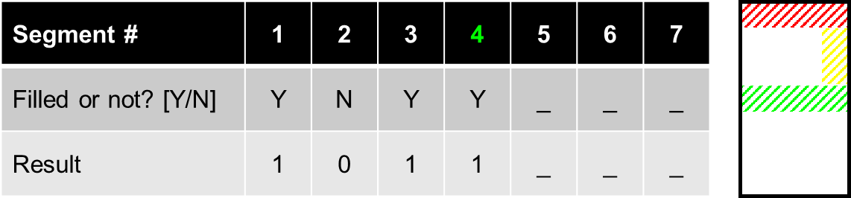
Sweeping each segment: 4th segment
Notes:
1 for 4th.

Slide 31

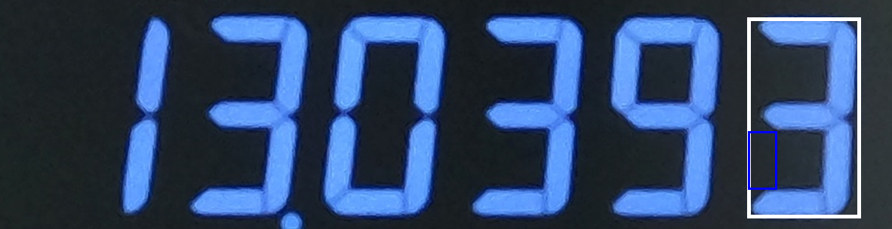
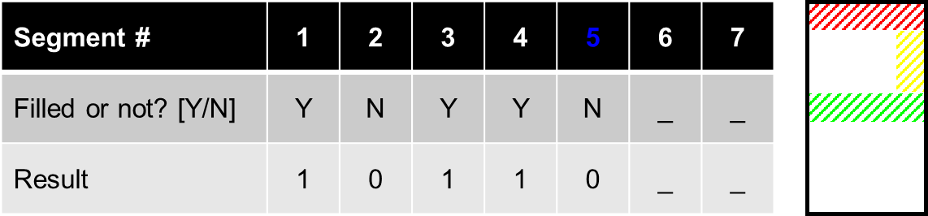
Sweeping each segment: 5th segment
Notes:
0 for 5th.

Slide 32

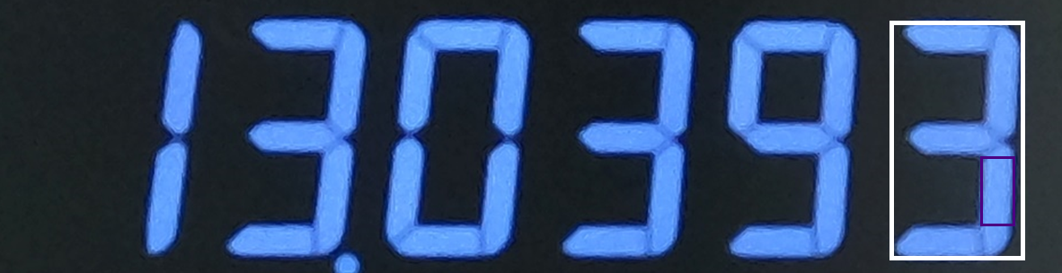
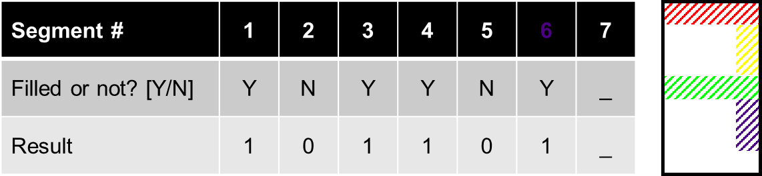
Sweeping each segment: 6th segment
Notes:
6th and

Slide 33

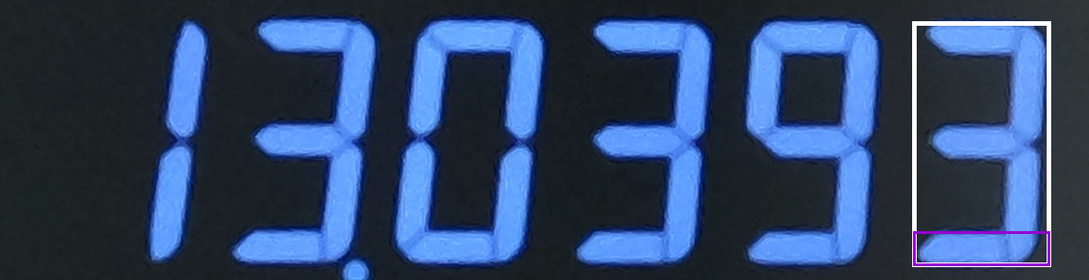
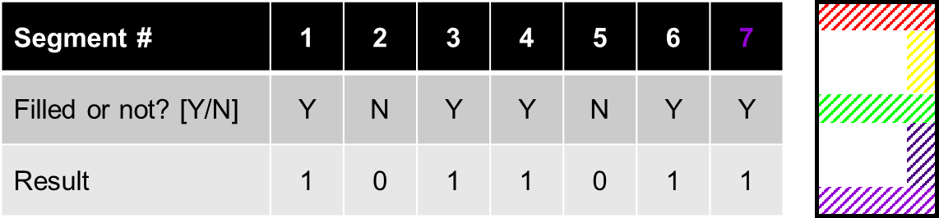
Sweeping each segment: 7th segment
Notes:
7th. Both segments are filled, so we have 1 for both cases.

Slide 34
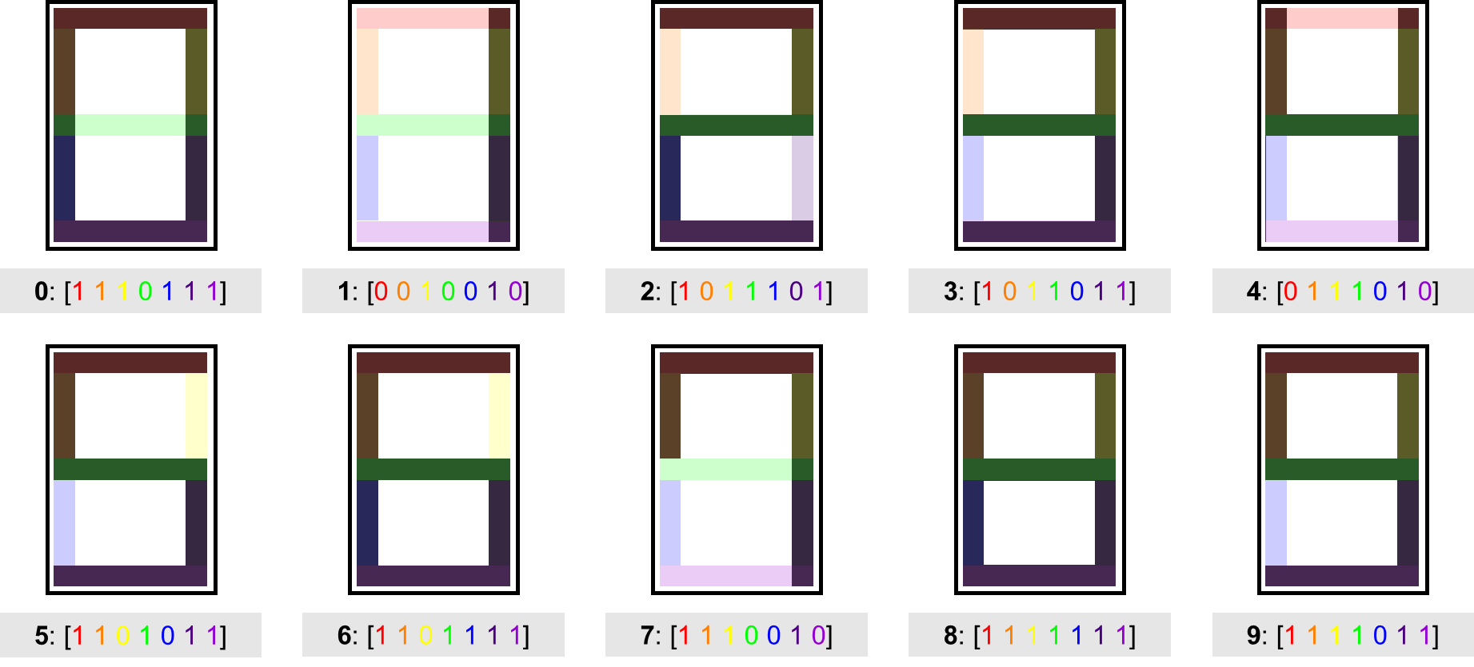
Results can be decided by Look-Up Table (LUT)
Notes:
From this result, the program can decide which number the result matches with using Look-Up Table that you can see here. This is how our code is working and deciding which number each bounding box has.

Slide 35
Performance of the seven-segment digit recognition algorithm
Performance
Notes:
Main title: 40 pt. Arial
Presenter Name: 16 pt. Arial
Presenters Title: 16 pt. Arial Italic

Slide 36
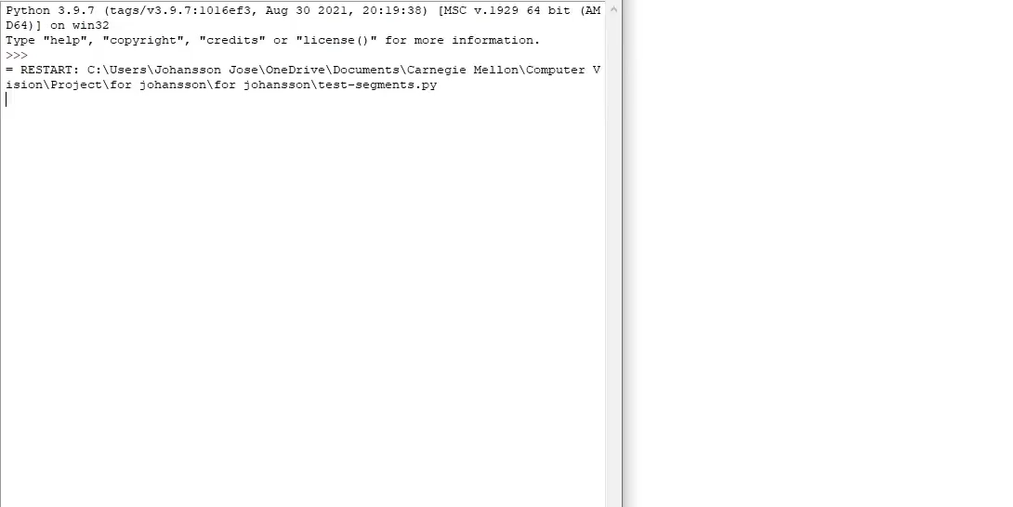

Performance
Notes:
To evaluate our performance, we’re emphasizing speed to make our program as convenient as possible while also being accurate. This video I’m about to show has been sped up but it demonstrates the accuracy of our program in reading a dataset of images. (Play vid) So most of the pictures have been read and plotted well with the exception of this singular blip. This occurs because an error is indicated on the graph as a negative 1.

Slide 37
SmartReader can be a third hand of many researchers!
Conclusion
Notes:
Here in this section, we can conclude that our program SmartReader can be a third hand of many researchers.

Slide 38
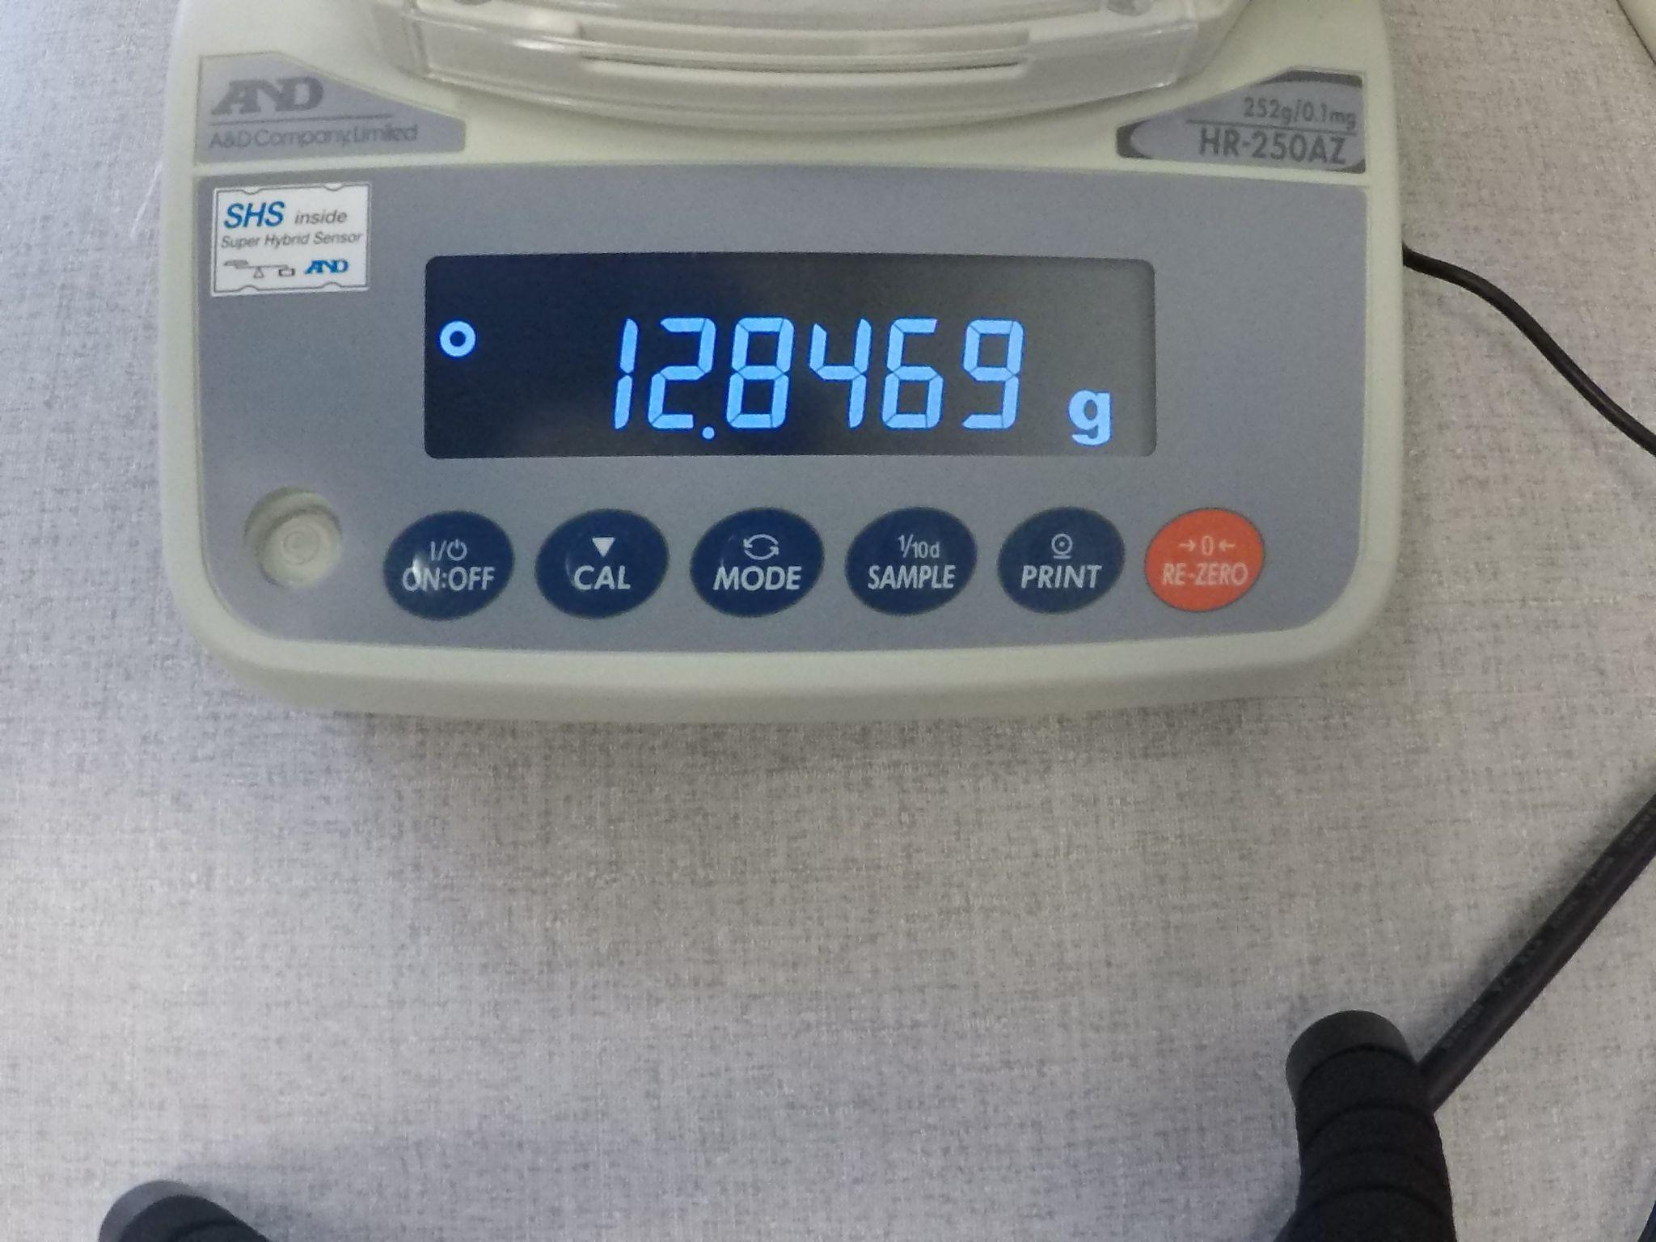
SmartReader is fast and accurate
Time spent:
99.4 seconds / 3535 characters
~ 99.4 seconds / 505 images
~ 1 second / 5 images
~ 5 fps
This is 10.4 times faster than the speed (~3.5 character/second) of average computer typists.
Accuracy:
504 images out of 505 images.
=> 99.8%
505 images were processed.
Each image has 7 characters.
This is 6.8% higher than the accuracy (92%) of average computer typists.
[Ref 1] https://www.ratatype.com/learn/average-typing-speed/
Notes:
Based on the performance, the program can process 505 images within 100 seconds. This is 10.4 times faster than the speed of average computer typists. For accuracy of the recognition, we have 99.8% which means that we got only one error out of 505 images. This is 6.8% higher than the accuracy of average computer typists.

Slide 39
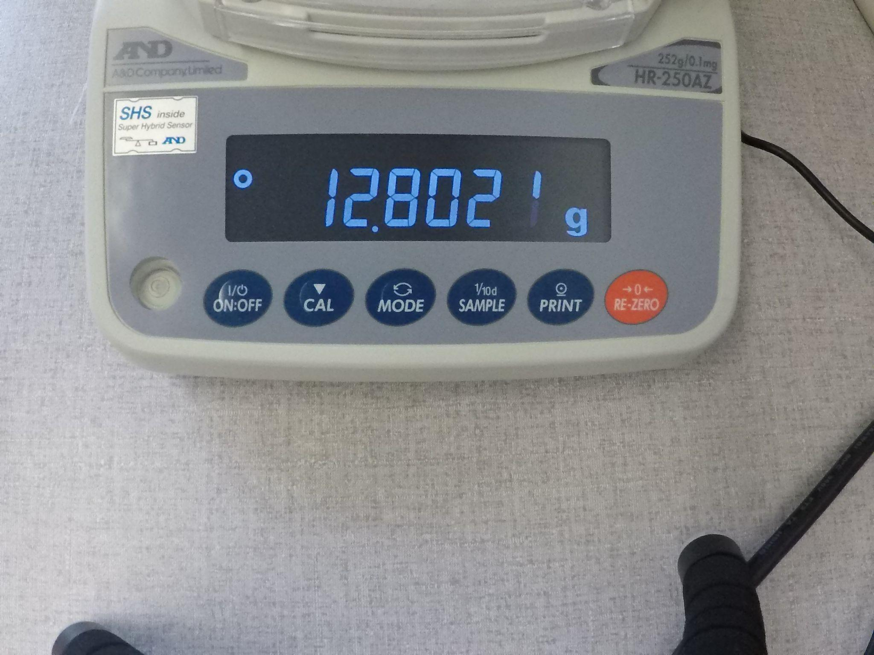
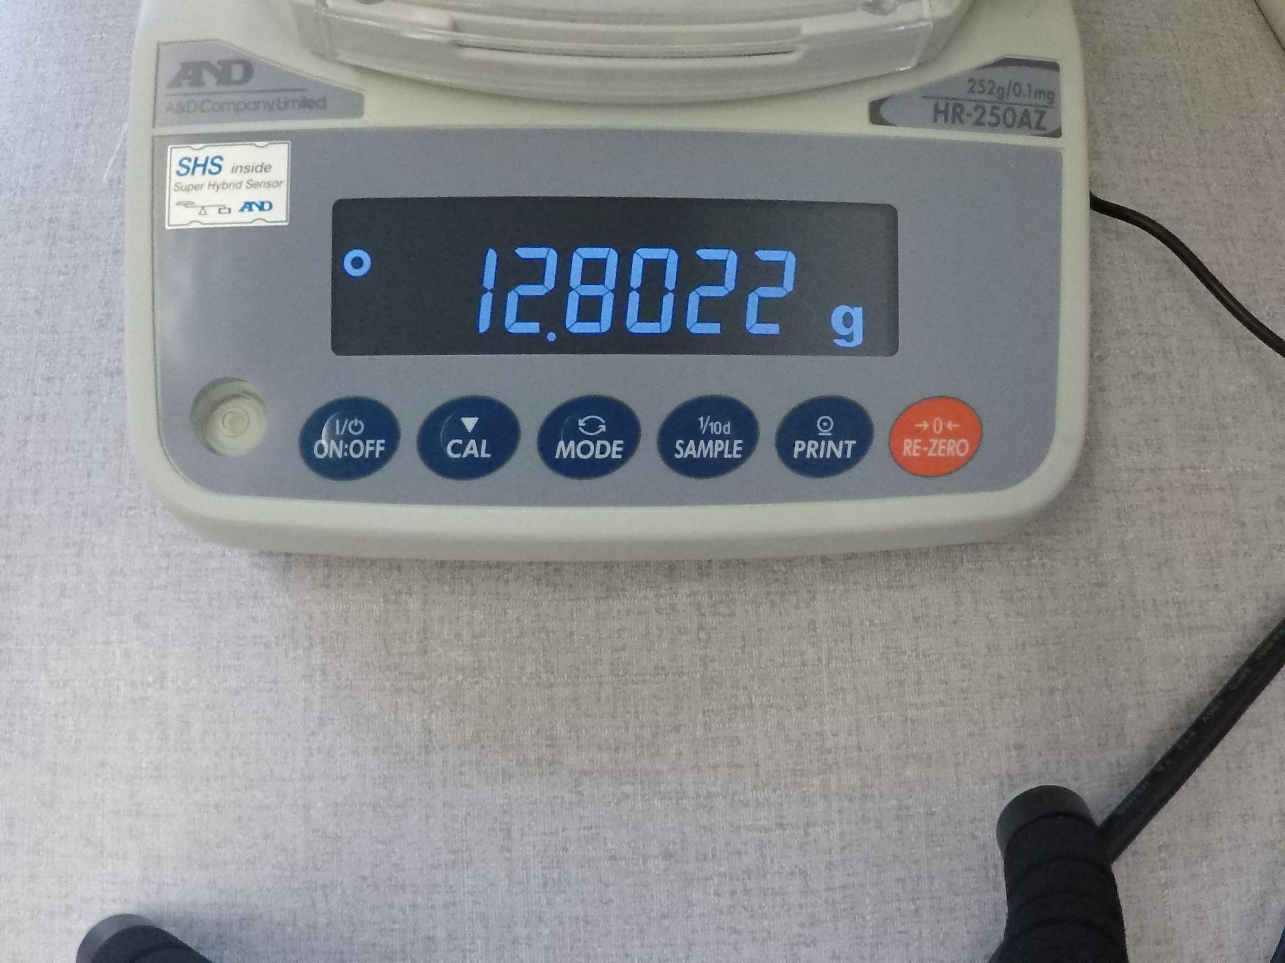
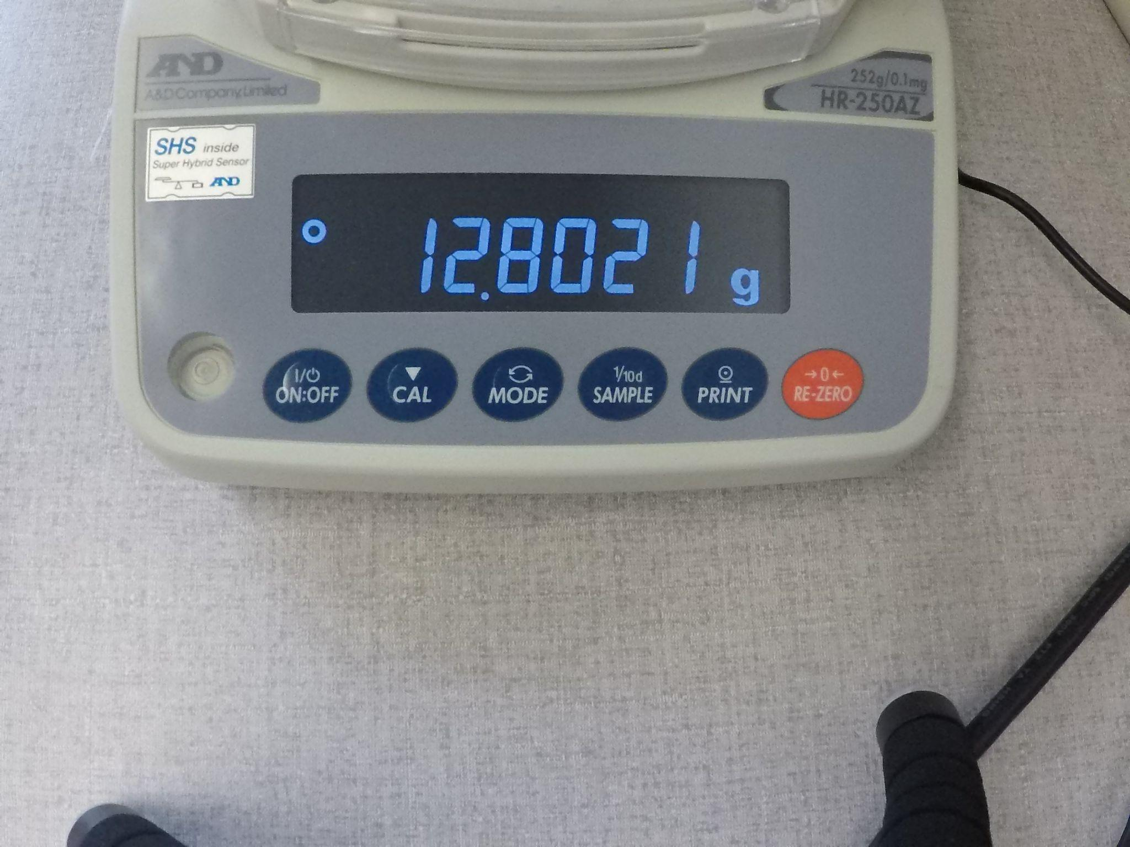
There is still a lot of room for improvement
Before:
After:
The image can capture transitional moment.
The algorithm cannot find a matching result from Look-Up Table (LUT).
We can guess the result by comparing images before and after.
Notes:
Not every program can be perfect. If some transitional moment is captured, the program cannot recognize the digit because it doesn’t match with any number in the Look-Up Table. In this case, we can do interpolation using the images before and after. For this specific case, it can be 12.80215. However, these cases are relatively rare, and they do not affect the overall performance of our program.

Slide 40


Thank You
Notes:
Well we are team SmartReader and this is what we have. Thank you all for listening and we are happy to answer any questions.

